Slide 1

Study Calendar
IHC 2nd Assignment Final Presentation
P3 - 2020/2021
Eva Bartolomeu 98513
Filipe Gonçalves 98083
Pedro Sobral 98491

Slide 2
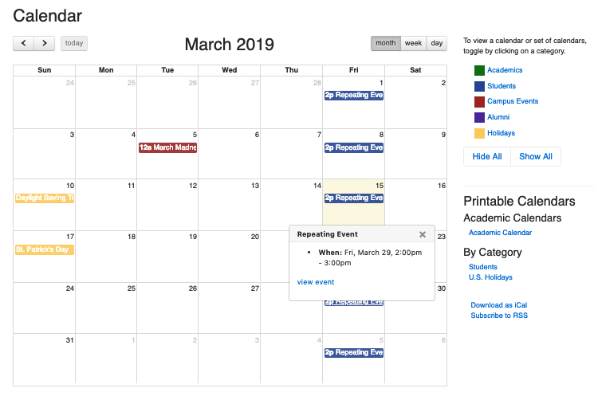
Introduction
Contextualization
Why this idea?
Personal Interest
StudyCalendar

Slide 3
Objectives
Goals
Organize and track the events of UA students and teachers;
Benefits
Makes the study more efficient for the students;
Makes the scheduling of events faster and more efficient;
StudyCalendar

Slide 4
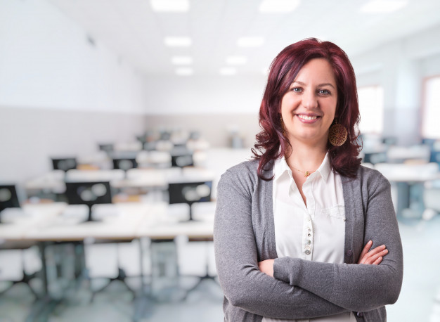
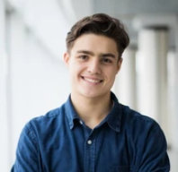
Personas
Name: Anita Pinto
Job Title: Programming teacher at the University of Aveiro
Goals and task:
Consulting her next events;
Track the events of the subgroups;
Demographics:
30 years old;
Environment:
Using the StudyCalendar it’s easy to keep in check the evaluation moments of your classes, even with many classes.
Name: João Carlos
Student at University of Aveiro
Goals and task:
Organize the academic and personal calendar.
Demographics:
19 years old;
Environment:
With many courses to study, it’s a little struggling to maintain everything organized.
StudyCalendar

Slide 5

Scenarios
Scenery 1 (Anita wants to create team calendars for each group in each practical class):
Divide the students in practical classes
Divide the students in groups
See their development throughout the semester
Scenery 2 (João wants to create an event for his team):
Wants to book a period of days to work with his team
Share the event with the team
StudyCalendar

Slide 6
Tasks
Creating team calendars for each group in each practical class
0- Enter e-learning
Plan 0: in order
1- Open Calendar
2- Create group called “Practical classes”
Plan 2: choose a path
Plan 2.1: repeat for every class
2.1- Create group for Practical class
2.2- Create groups for each group in each practical class
Plan 2.2: repeat for every group
Plan 2.1.1: repeat for every group
2.1.1- Create group for group in practical class
3- “Invite” each student of that group
StudyCalendar

Slide 7
Tasks
João wants to create an event for his team
0- Enter e-learning
Plan 0: in order
1- Open Calendar
2- Look for your group calendar
3- Create event for your group
4- Notify the team of the event
StudyCalendar

Slide 8

Requirements - Functional
The teacher can create/delete/edit groups and subgroups;
The group creator can add others teachers as administrators;
The group administrator can mark/remove/edit events in his respective group;
The student can mark/remove/edit events in subgroups;
The users can search events;
During the process of the creation and edition of events, the user can add/delete:
a reminder;
the periodicity of the event with a limite date;
a location or link of the event;
an annex;
some notes.
StudyCalendar

Slide 9
Requirements - Non Functional
Database security
An account should have the same information across all devices
Easily accessible menu and interface to create a new event in calendar
Documentation
The application must be available all the time
StudyCalendar

Slide 10
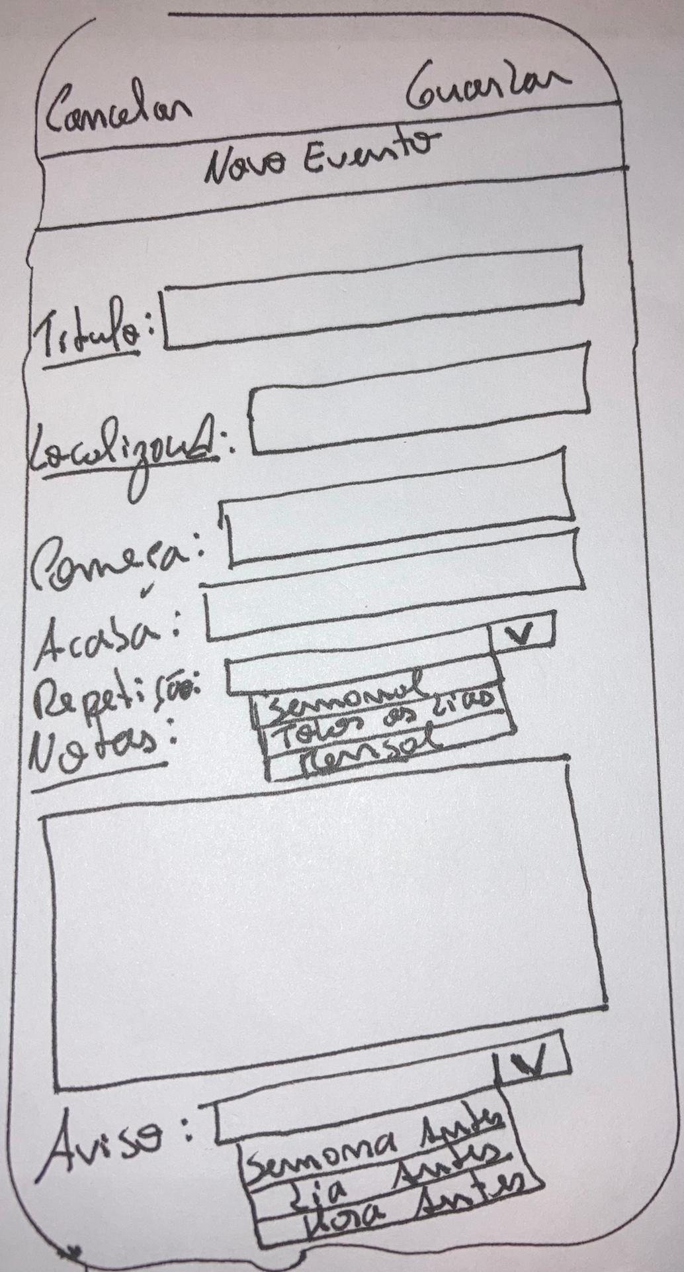
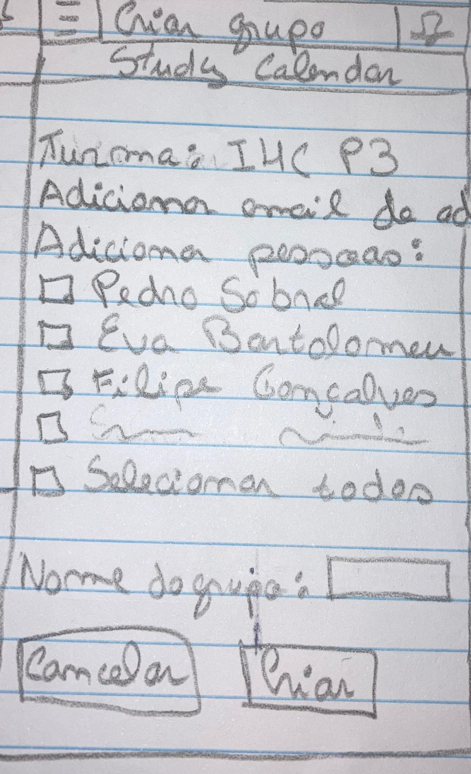
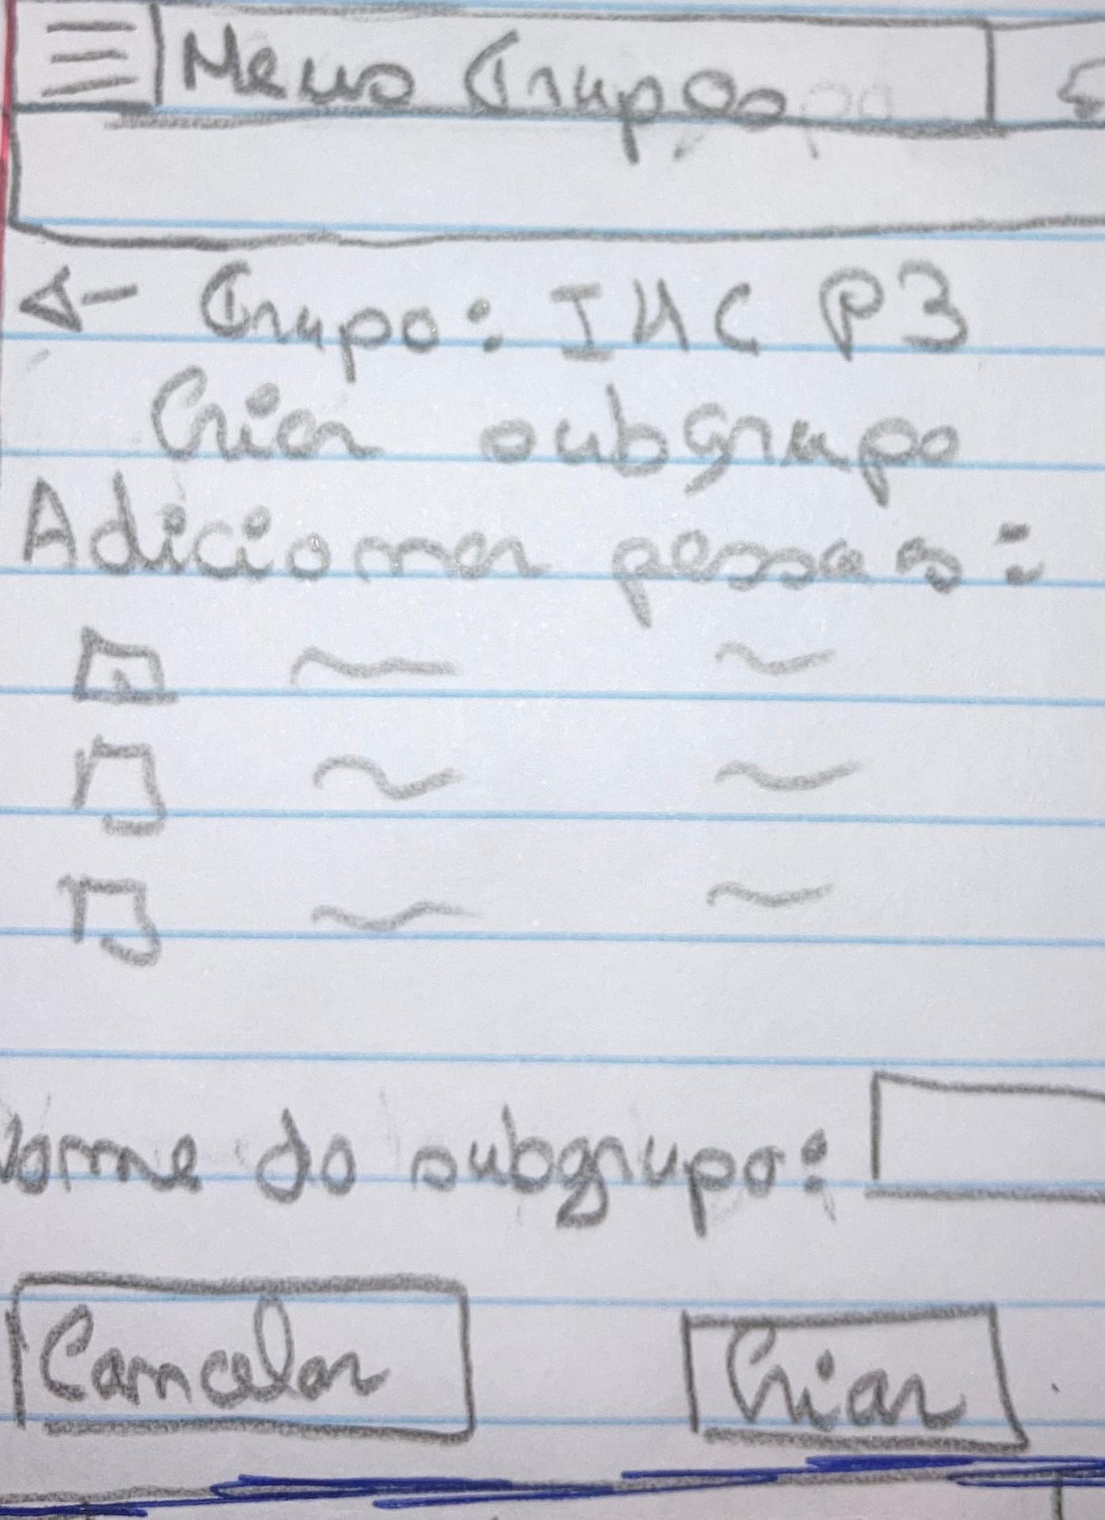
Low Fidelity Prototype
The prototype was made in paper, and has the following main functionalities:
Create an event.
Create a group
Create a subgroup
StudyCalendar

Slide 11

LFP - User Evaluation
Find main usability problems
Find main errors and inconsistency
Workflow of tasks made sense
The tasks that we chose were:
Create a group on a IHC course with the name “P7”.
Create a subgroup on “IHC P3” group.
Add an event on calendar in 27th of June.
StudyCalendar

Slide 12
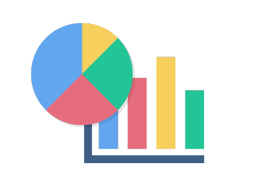
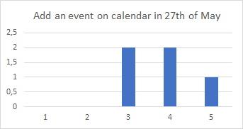
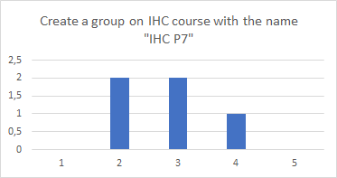
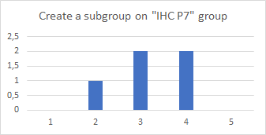
LFP - User Evaluation Results
The tests were made by five people, four students and one teacher.
1 - Very Difficult 2 - Difficult 3 - Normal 4 - Easy 5 - Very Easy
StudyCalendar

Slide 13

LFP - User Evaluation Results
Feedback from users:
Add courses, available on main page
Add a week view on calendar
Add filter with courses, groups, and subgroups
Turn multiple pages into some pages
StudyCalendar

Slide 14



Tools Used for the Functional Prototype
As the core of our ideia is a calendar, we decided to develop a website using:
Angular, Node.js, Typescript, Html and CSS
VS Code, for coding
Linux bash or Windows cmd for compiling
GitHub for code sharing
StudyCalendar

Slide 15

High Fidelity Prototype
We tested the same tasks, but now having made changes that matches with feedback from previous testers.
We improved:
Better menu
Less pages
More robust
More colorful, more text
More views on calendar
StudyCalendar

Slide 16
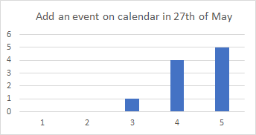
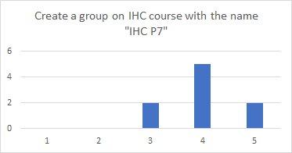
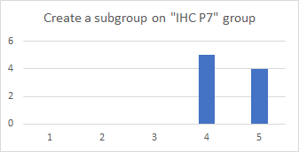
HFP - User Evaluation Results
We had more testers, 7 students and 2 teacher.
1 - Very Difficult 2 - Difficult 3 - Normal 4 - Easy 5 - Very Easy
StudyCalendar

Slide 17
HFP - User Evaluation Results
Feedback from users:
Confusing placement of buttons
Direct route to tasks not visible
Menu not visible enough
StudyCalendar

Slide 18
Low Fidelity Prototype vs.High Fidelity Prototype
Task | Description | LFP | HFP
1. | Add an event on calendar in 27th of May | 3,8 | 4,8
2. | Create a group on a IHC course with the name “IHC P7” | 2,8 | 4
3. | Create a subgroup on “IHC P7” group. | 3,2 | 4,4
StudyCalendar

Slide 19
Heuristic Evaluation on Functional Prototype
Problem - Heuristic | Daniel | André | Marta
Colors aren’t very appellative - Aesthetic & Minimalist Design | 3 | - | 4
Can’t edit or delete a event - User control & Freedom | 4 | 3 | 2
On home page, confusion on select options and calendar on courses page - Consistency & Standards | - | - | 3
StudyCalendar

Slide 20
Demo
StudyCalendar

Slide 21

What’s Next
Notifications via mail / Reminders
Real database for students, events and groups/subgroups
Edit/Remove events, groups and subgroups
Repetition of events
Confirmation when doing a task
Better Event view
Forms validation for group/subgroup and event creation
StudyCalendar

Slide 22
Acknowledgments
Special thanks to:
• Participants who contributed to gave us a valid feedback of the application.
• IHC teachers for helping us and also giving some suggestions.
Eva Bartolomeu 100/3%
Filipe Gonçalves 100/3%
Pedro Sobral 100/3%
StudyCalendar

Slide 23
QUESTIONS?
StudyCalendar

